Slide 1

Machine Learning Guild
Midpoint Code Review
Emerging Tech and Tech Leadership

Slide 2
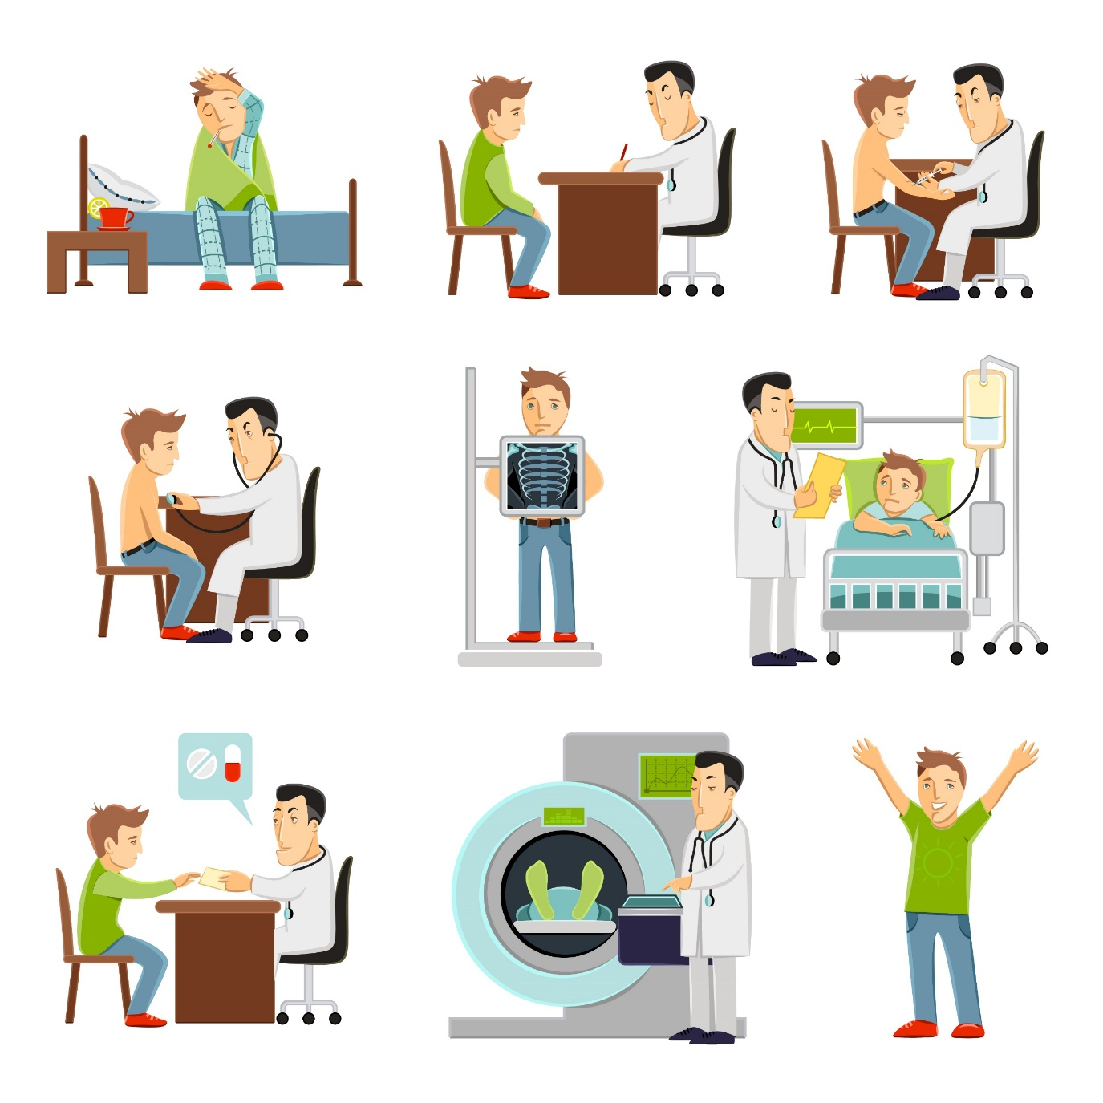
Capstone | Overview
Please provide details around the use case, how the model will solve this use case, and who / how it will be used (final product)
1. Automobile accidents are very common in nature and requires good amount of assessment from Adjustors to define the associated loss with the claim.
2. Additionally loss ratio is a key factor that drives the insurance company.
Understanding what all factors impact Claims.
Objective of this problem statement is to predict claims loss amount so that insurance company can keep a check on premium pricing and overall loss ratio.
Perform EDA to understand relation between various factors contributing the claims calculation
Create multi linear regression model to identify the claims amount for any automobile insurance.
Helps in predicting claims using initial information about loss and insured.
This can be used across multiple products within automobile insurance as a predictive model.
It will help in keeping a check on the overall loss ratio for the insurer.
Determining the pricing/premium strategy for different customers.

Slide 3
Capstone | Approach Summary
Please describe the data you are using, key analysis and EDA, and what the final product was / is and the accuracy.
Data Sources
Key Fields
Model Results
Since Insurance data is difficult to get from Insurance provider hence, relying on Open source insurance dataset.
Open source dataset available for insurance : https://www.kaggle.com/xiaomengsun/car-insurance-claim-data
KIDSDRIV
BIRTH
AGE
HOMEKIDS
YOJ
INCOME
PARENT1
HOME_VAL
MSTATUS
GENDER
EDUCATION
OCCUPATION
TRAVTIME
CAR_USE
BLUEBOOK
Root Mean_Squared_Error : 2970.002874724514
Mean_Squared_Error : 8820917.07587188
3. r_square_value 0.3507129457043936
TIF
CAR_TYPE
RED_CAR
OLDCLAIM
CLM_FREQ
REVOKED
MVR_PTS
CLM_AMT
CAR_AGE
CLAIM_FLAG
URBANICITY

Slide 4
Capstone | Data Pathway
Please show how your data moves from raw to model ready- include any major steps such as feature engineering, grouping, binning, encoding categorical features, PCA, autoencoders, NLP, etc. Be detailed! Add more bubbles!
Data Visualization
Dataset
Model
Dummifying
Model
Feature Engineering
Data Cleansing
Standardizing

Slide 5
Capstone | Next Steps
A : Model Tuning to Improve the performance
B : Stacking the models to use outcome from all models/ using TabNet
C : Model application building using flask / heroku
D : Deploying the model on the application

Slide 6
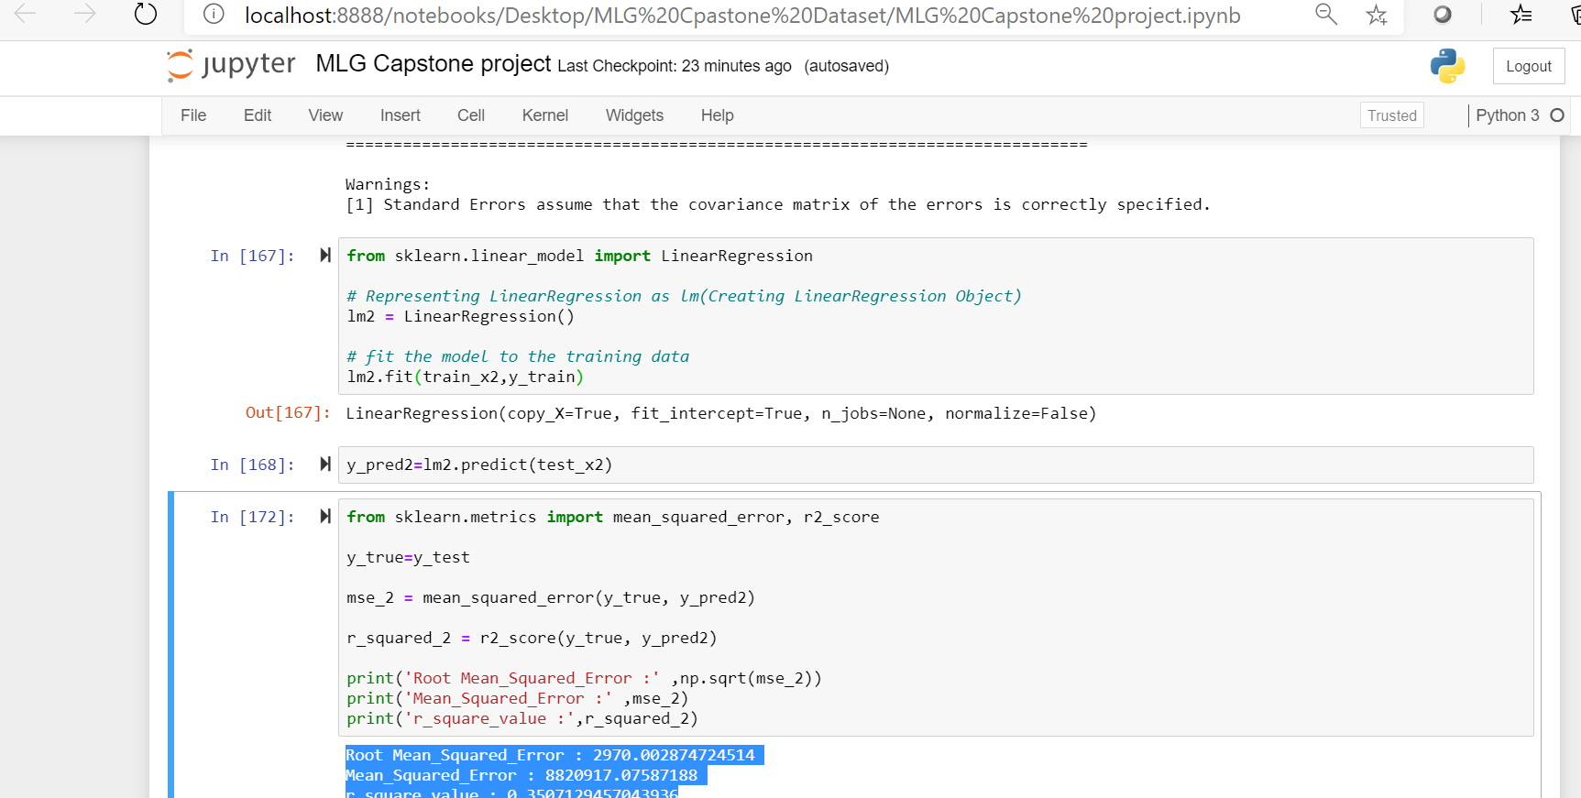
Appendix | Code Snippets
Include code snippets with explanation (if necessary) to explain slide 3

